Slide 1
Semantic Composition with PSHRG for Derivation Tree Reconstruction from Graph-Based Meaning Representations
Chun Hei Lo, Wai Lam and Hong Cheng
Notes:
// This is a presentation on our paper titled “Semantic Composition with PSHRG for Derivation Tree Reconstruction from Graph-Based Meaning Representations”.
I am Chun Hei Lo from the Chinese University of Hong Kong

Slide 2
What is in this talk
A summary of what is in the paper
What is not discussed extensively in the paper
Notes:
In this talk, I will be introducing a data-driven approach to generating derivation trees from
meaning representation graphs by approximating the semantic compositions with
probabilistic synchronous hyperedge replacement grammar, or PSHRG.
I will break down the many concepts and go through them one by one.
Before that, let me spare a few slides to provide context for the work.

Slide 3
Overview
We introduce a data-driven approach to generating derivation trees from meaning representation graphs by approximating the semantic compositions with probabilistic synchronous hyperedge replacement grammar (PSHRG).
Notes:
In this talk, I will be introducing a data-driven approach to generating derivation trees from
meaning representation graphs by approximating the semantic compositions with
probabilistic synchronous hyperedge replacement grammar, or PSHRG.
I will break down the many concepts and go through them one by one.
Before that, let me spare a few slides to provide context for the work.

Slide 4
Text to/from Graph
Semantic Parsing
Some boys want to go.
Surface Realization
Notes:
In semantic parsing, texts are transformed into semantic structures
such as graph-based meaning representations.
End-to-end neural methods have recently played a large part in data-driven semantic parsing.
Contrasted to the neural methods are the rule-based methods, where formal grammars are adopted.

Slide 5

Motivations
Linguistic assumptions
Formal grammars
Data-driven semantic parsing
Cross-framework adaptability
Explainability
Approximation for computational purposes
Notes:
Graph grammars and algebras that formalize semantic constructions were introduced
to bridge between linguistic assumptions and data-driven semantic parsing.
[click]
They can potentially be used across frameworks of meaning representations,
to formalize or approximate the underlying relations and patterns between texts and graphs,
which can be desirable for computational considerations such as efficiency.

Slide 6
Graph to Tree/Text
?
Formal grammars
Some boys want to go.
Notes:
Although there are many attempts of adopting formal grammars in semantic parsing,
their use in recovering syntax trees and texts from semantic graphs,
so we are interested to see what we can do here.

Slide 7
Graph-Based Meaning Representations
Some boys want to go.
Dependency Minimal Recursion Semantics (DMRS)
Notes:
Graph-Based Meaning Representations are designed for modelling sentence-level semantics
For example, here is a meaning representation graph for the sentence Some boys want to go.
Generally, the nodes in the graphs represent words and
the edges encode the semantic dependencies between the words.
[Click]
The representation we investigate is Dependency Minimal Recursion Semantics, or DMRS.

Slide 8
DMRS Scope-Underspecified Logical Form
Notes:
With respect to a sentence, a DMRS can be derived along with an derivation tree
using the English Resource Grammar, abbreviated as the ERG,
a broad-coverage hand-engineered HPSG grammar of English.

Slide 9
DMRS Derivation
ERG
Some boys want to go.
HPSG Derivation Tree
Notes:
With respect to a sentence, a DMRS can be derived along with an derivation tree
using the English Resource Grammar, abbreviated as the ERG,
a broad-coverage hand-engineered HPSG grammar of English.

Slide 10
Derivation Tree Reconstruction
f
Some boys want to go.
Notes:
The main objective of our work is to provide a method for
reconstructing the derivation tree of a meaning representation graph,
[Click]
and possibly natural language, if the terminals of the derivation tree are realized,
without using the gold-standard ERG.

Slide 11
Related Work
On surface realization from ERG semantics
Data-driven methods:
DAG Transducer (Ye et al., ACL 2018) (from Elementary Dependency Structure (EDS))
Produces interpretable intermediate syntactic analysis: No;
Requires an HPSG grammar: No
Neural MRS (from DMRS)
Produces interpretable intermediate syntactic analysis: No;
Requires an HPSG grammar: No
HPSG grammar-based generator:
The Answer Constraint Engine (ACE)
Produces interpretable intermediate syntactic analysis: Yes (gold-standard);
Requires an HPSG grammar: Yes
Notes:
The main objective of our work is to provide a method for
reconstructing the derivation tree of a meaning representation graph,
[Click]
and possibly natural language, if the terminals of the derivation tree are realized,
without using the gold-standard ERG.

Slide 12
Related Work
On semantic parsing to ERG semantics
Data-driven method:
An SHRG-based parser (Chen et al., ACL 2018)
Produces interpretable intermediate syntactic analysis: Yes;
Requires a HPSG grammar: No
HPSG grammar-based generator:
The Answer Constraint Engine (ACE)
Produces interpretable intermediate syntactic analysis: Yes (gold-standard);
Requires an HPSG grammar: Yes
Notes:
The main objective of our work is to provide a method for
reconstructing the derivation tree of a meaning representation graph,
[Click]
and possibly natural language, if the terminals of the derivation tree are realized,
without using the gold-standard ERG.

Slide 13
Semantic Composition
_want_v_1(e₁, x₁,
x₂
h₁
)
_go_v_1(e₂, )
Notes:
Now, I will illustrate the idea of semantic composition in DMRS with an example.
[Click]
First, here is a DMRS node 'want' with two edges representing argument relations.
[Click]
We may also represent this in a logical form, like this.
[Click][Click]
Similarly, we have 'go' in the two forms.

Slide 14
Semantic Composition
_want_v_1(e₁, x₁,
x₂
h₁
)
_go_v_1(e₂, )

Slide 15
Semantic Composition
_want_v_1(e₁, x₁,
x₁
h₁
)
_go_v_1(e₂, )

Slide 16
Semantic Composition
_some_q( ,
h₂
, h₃)
_boy_n_1( )
_want_v_1(e₁, x₁,
x₁
x₄
h₁
x₃
)
_go_v_1(e₂, )
Notes:
When semantic composition takes place between want and go,
the two graphs merge together,
and the scope is resolved by identifying the variable h1 with the predicate go.
Therefore, semantic composition of DMRS can be interpreted
both at the graph level as well as the logical form level.
[Click]
Here we have two more predicates, a noun boy and a quantifier some.

Slide 17
Semantic Composition
_some_q( ,
h₂
, h₃)
_boy_n_1( )
_want_v_1(e₁, x₁,
x₁
x₄
h₁
x₃
)
_go_v_1(e₂, )
Notes:
The two words are then composed

Slide 18
Semantic Composition
_some_q( ,
h₂
, h₃)
_boy_n_1( )
_want_v_1(e₁, x₁,
x₁
x₃
h₁
x₃
)
_go_v_1(e₂, )
Notes:
The two words are then composed

Slide 19
Semantic Composition
_some_q( ,
h₂
, h₃)
_boy_n_1( )
_want_v_1(e₁, x₁,
x₁
x₃
h₁
x₃
)
_go_v_1(e₂, )
Notes:
Finally, we obtain the DMRS and logical form of some boys want to go,
[Click]
by equating x3 to x1, since some boys is the argument 1 of both want and go.
[Click]
In this work, we try to approximate the composition process with PSHRG,
which I am going to introduce now.

Slide 20
Semantic Composition
_some_q( ,
h₂
, h₃)
_boy_n_1( )
_want_v_1(e₁, x₁,
x₁
x₁
h₁
x₁
)
_go_v_1(e₂, )
TOP
_some_q(x₁, _boy_n_1(x₁), _want_v_1(e₁, x₁, _go_v_1(e₂, x₁)))
HRG
Approximated with PSHRG
Notes:
Finally, we obtain the DMRS and logical form of some boys want to go,
[Click]
by equating x3 to x1, since some boys is the argument 1 of both want and go.
[Click]
In this work, we try to approximate the composition process with PSHRG,
which I am going to introduce now.

Slide 21
Semantic Composition
HRG
Approximated with PSHRG
_want_v_1(e₁, x₁,
x₁
h₁
)
_go_v_1(e₂, )
1
2

Slide 22
Semantic Composition
HRG
Approximated with PSHRG
_some_q( ,
h₂
, h₃)
_boy_n_1( )
_want_v_1(e₁, x₁,
x₁
x₃
h₁
x₃
)
_go_v_1(e₂, )
1
1
1
2
ARG1/NEQ
Some boys
1
1
want to go
ARG1/NEQ
2
Notes:
The two words are then composed

Slide 23
Semantic Composition
HRG
Approximated with PSHRG
_some_q( ,
h₂
, h₃)
_boy_n_1( )
_want_v_1(e₁, x₁,
x₁
x₃
h₁
x₃
)
_go_v_1(e₂, )
ARG1/NEQ
S
Some boys
1
1
want to go
ARG1/NEQ
2
Notes:
Finally, we obtain the DMRS and logical form of some boys want to go,
[Click]
by equating x3 to x1, since some boys is the argument 1 of both want and go.
[Click]
In this work, we try to approximate the composition process with PSHRG,
which I am going to introduce now.

Slide 24
Synchronous Hyperedge Replacement Grammar (SHRG) DMRS as hypergraph
Notes:
We may represent a DMRS as a hypergraph, as shown.
[Click]
which consists of unlabelled nodes and labelled hyperedges. Each hyperedge connects to one or more nodes.
/*
In the example graphs here, the left one is a DMRS, and the right one is the hypergraph that corresponds to it.
A hypergraph consists of unlabelled nodes and labelled hyperedges.
A hyperedge connects to one or more distinct nodes.
A labelled rectangle represents a labelled hyperedge.
[Click]
The numbered rounded rectangles attached to each hyperedge denote the ordered collection of nodes the hyperedge connects to, each of which corresponds to a DMRS node.
*/

Slide 25
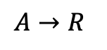
Synchronous Hyperedge Replacement Grammar (SHRG) HRG
$$A→R$$
Notes:
Moving on to Synchronous HRG, or SHRG, it defines a mapping between HRG and CFG.
[Click]

Slide 26
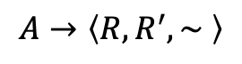
Synchronous Hyperedge Replacement Grammar (SHRG) A mapping between HRG and CFG
$$A→\left\langle R, R^{′}, \sim \right\rangle$$
Notes:
HRG stands for hyperedge replacement grammar,
which is a context-free rewriting formalism for generating graphs.
A synchronous HRG defines a mapping between an HRG and a CFG.
Here are five SHRG productions, which define how graphs and strings are rewritten synchronously.
Each production rewrites a nonterminal hyperedge to a hypergraph fragment by an HRG,
and a nonterminal symbol to a symbol sequence by a CFG.
[Click]
The following animation shows how the synchronous rewriting is performed.
// A set of special nodes with respect to called the external nodes, which are responsible for gluing the graphs together.

Slide 27
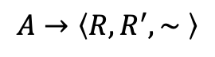
Synchronous Hyperedge Replacement Grammar (SHRG) A mapping between HRG and CFG
$$A→\left\langle R, R^{′}, \sim \right\rangle$$

Slide 28
Synchronous Hyperedge Replacement Grammar (SHRG) A mapping between HRG and CFG
$$A→\left\langle R, R^{′}, \sim \right\rangle$$

Slide 29
Synchronous Hyperedge Replacement Grammar (SHRG) A mapping between HRG and CFG
$$A→\left\langle R, R^{′}, \sim \right\rangle$$

Slide 30
Synchronous Hyperedge Replacement Grammar (SHRG) A mapping between HRG and CFG
$$A→\left\langle R, R^{′}, \sim \right\rangle$$

Slide 31
Synchronous Hyperedge Replacement Grammar (SHRG) A mapping between HRG and CFG
$$A→\left\langle R, R^{′}, \sim \right\rangle$$

Slide 32
Synchronous Hyperedge Replacement Grammar (SHRG) A mapping between HRG and CFG
$$A→\left\langle R, R^{′}, \sim \right\rangle$$

Slide 33
Synchronous Hyperedge Replacement Grammar (SHRG) A mapping between HRG and CFG
$$A→\left\langle R, R^{′}, \sim \right\rangle$$

Slide 34
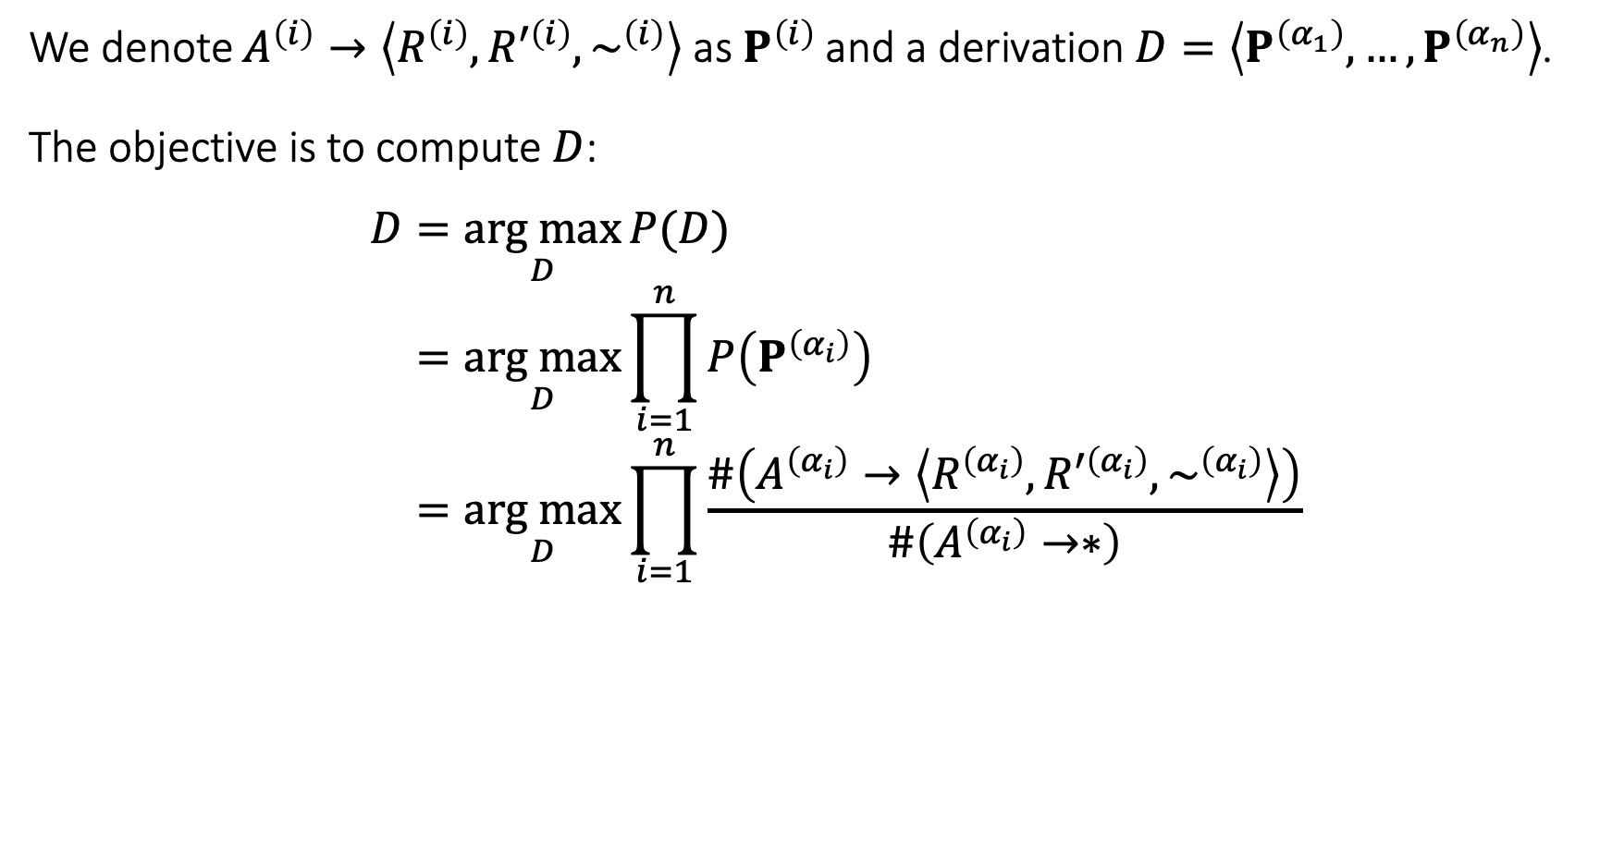
Probabilistic SHRG (PSHRG) A simple frequency-based probability model for SHRG
We denote $A^{\left(i\right)}→\left\langle R^{\left(i\right)}, R^{′\left(i\right)}, \sim ^{\left(i\right)}\right\rangle$ as $P^{\left(i\right)}$ and a derivation $D=\left\langle P^{\left(α_{1}\right)},…,P^{\left(α_{n}\right)}\right\rangle$.
The objective is to compute $D$:
$$D=\underset{D}{arg max}{P(D)} \\ =\underset{D}{arg max}{\prod_{i=1}^{n}{P\left(P^{\left(α_{i}\right)}\right)}} \\ =\underset{D}{arg max}{\prod_{i=1}^{n}{\frac{\#\left(A^{\left(α_{i}\right)}→\left\langle R^{\left(α_{i}\right)}, R^{′\left(α_{i}\right)}, \sim ^{\left(α_{i}\right)}\right\rangle \right)}{\#\left(A^{\left(α_{i}\right)}→∗\right)}}}$$
Notes:
Then, a PSHRG is simply a probability model for SHRG.
[Click]
In our implementation, we simply define the probability of an SHRG derivation
to be the product of the probabilities of the SHRG productions applied,
whereas the probability of each SHRG production is a frequency-based estimation from the training data.

Slide 35
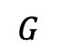
PSHRG Induction
Induction
Aligned trees and graphs
$$G$$
Notes:
In our pipeline, we first induce a PSHRG from the training data,
which should consist of pairs of trees and graphs
where the nodes are aligned in each pair, as shown by the colours here.
We can obtain a grammar G, by a bottom-up induction process.

Slide 36
PSHRG Parsing
Parsing
$$G$$
DMRS
Derivation Tree
Notes:
When we have obtained a PSHRG G, we can use it to parse a DMRS,
which means to obtain the derivation of the DMRS hypergraph with the highest probability.
Synchronously, a derivation tree is reconstructed, which hopefully corresponds to the syntax tree that licenses the DMRS.
Please check out our paper for some more adaptations for aligning PSHRG to the semantics of the DMRS.

Slide 37
PSHRG Adaptations
Complex semantics of lexical items

Slide 38
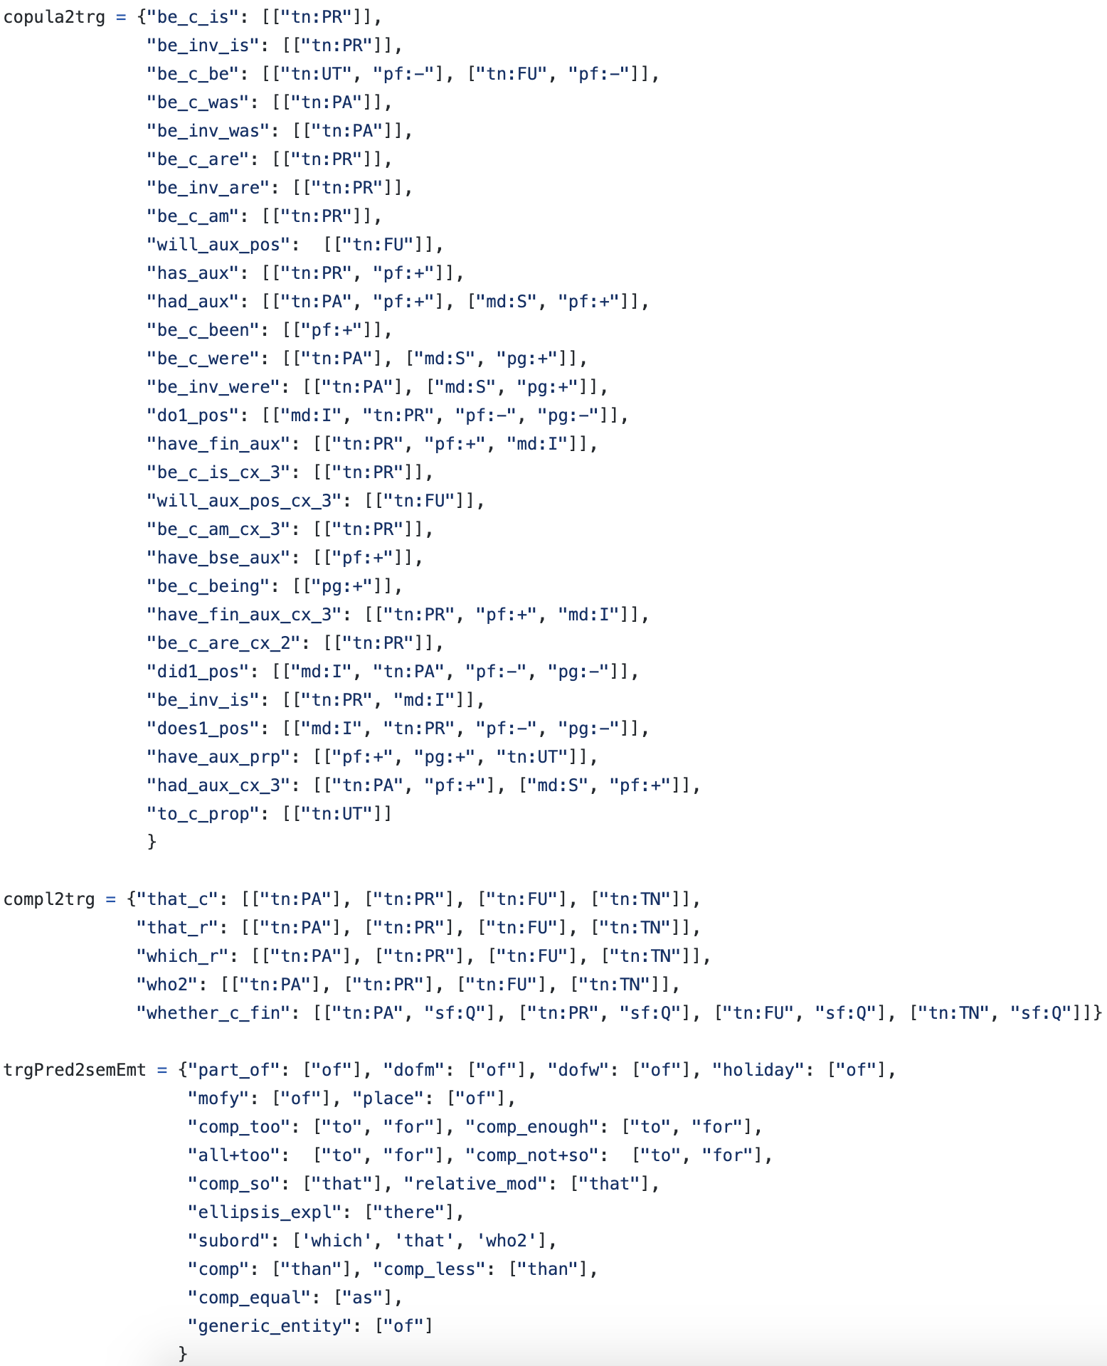
PSHRG Adaptations
tense: untensed
tense: untensed
tense: untensed
Empty semantics of lexical items

Slide 39
Towards Practical Grammar Approximation and Modelling
P3
Notes:
Now I am going to introduce some of the techniques we applied
to improves the precision and generalizability of the PSHRG approximation,
most of which target not only DMRS but to general meaning representation graph parsing by PSHRG.
You may refer to our paper for a full description.
I am going to illustrate the idea using this SHRG production from the previous slides.

Slide 40
Towards Practical Grammar Approximation and Modelling Annotations for Refining Compositions
P3
Typed HRG
Notes:
First, we may type a node by the major sense tag of the corresponding DMRS predicate.
[Click]
For example, both DMRS nodes involved here are of type v.
This refines SHRG productions with addtional information.

Slide 41
Towards Practical Grammar Approximation and Modelling Annotations for Refining Compositions
P3
Annotation and Normalization of Derivation
Notes:
We further annotate each syntactic construction with
that of their immediate parent and the syntactic category of the phrase.
[Click]
This adds extra contextual information to the constituents for estimation of the probability model.

Slide 42
Towards Practical Grammar Approximation and Modelling Annotations for Refining Compositions
_some_q( ,
h₂
, h₃)
_boy_n_1( )
_want_v_1(e₁, x₁,
x₁
x₃
h₁
x₃
)
_go_v_1(e₂, )
Framework-Specific Constraints
Notes:
The two words are then composed

Slide 43
Towards Practical Grammar Approximation and Modelling Annotations for Refining Compositions
_some_q( ,
h₂
, h₃)
_boy_n_1( )
_want_v_1(e₁, x₁,
x₁
x₃
h₁
x₃
)
_go_v_1(e₂, )
Framework-Specific Constraints
Notes:
Both the predicate want and go select boy as their argument 1.
[Click]
If the variable x3 introduced by boy is not accessible to the outside, semantic composition cannot occur.
[Click]
Therefore, When parsing a DMRS, we should ensure that the variables involved in subsequent compositions are accessible after each composition.

Slide 44
Towards Practical Grammar Approximation and Modelling Underspecification for Generalization
Extended HRG Productions
Notes:
Now, let us look at two extensions for better generalization.
[Click]
First, consider production H1. The fact that the hyperedge _boy_n_1
connects to an external node is not significant to the ‘some boy’ construction.
Therefore, we propose that when recognizing an HRG production 𝐴 → 𝑅 on a hypergraph,
the external nodes of 𝑅 should not be distinguished from the non-external nodes.

Slide 45
Towards Practical Grammar Approximation and Modelling Underspecification for Generalization
P3₃
P3₁
P3₂
P3₀
$P\left(\text{P}\text{3}\text{3}\right)=P\left(\text{P}\text{3}\text{2}\right)=P\left(\text{P}\text{3}\text{1}\right)$ $=P\left(\text{P}\text{3}\text{0}\right)$
Extended HRG Productions
Notes:
This effectively creates more SHRG productions that share the same probabilities
if their R.H.S. hypergraphs (minus external nodes) are identical

Slide 46
Towards Practical Grammar Approximation and Modelling Underspecification for Generalization
Delexicalization
Notes:
We further suggest that the PSHRG models are estimated based on delexicalized productions.
This trades lexical preciseness for better coverage and provides a solution to out of vocabulary problem.

Slide 47
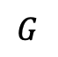
Experiments
We evaluate on two tasks:
$$G$$
Derivation Tree Reconstruction
Some boys want to go.
$$G$$
Surface Realization
Notes:
We evaluate our models on two tasks.
[Click]
The main experiment is on derivation tree reconstruction
[Click]
And the secondary experiment is on surface realization, which can be obtained by realizing the terminals of the derivation tree.

Slide 48
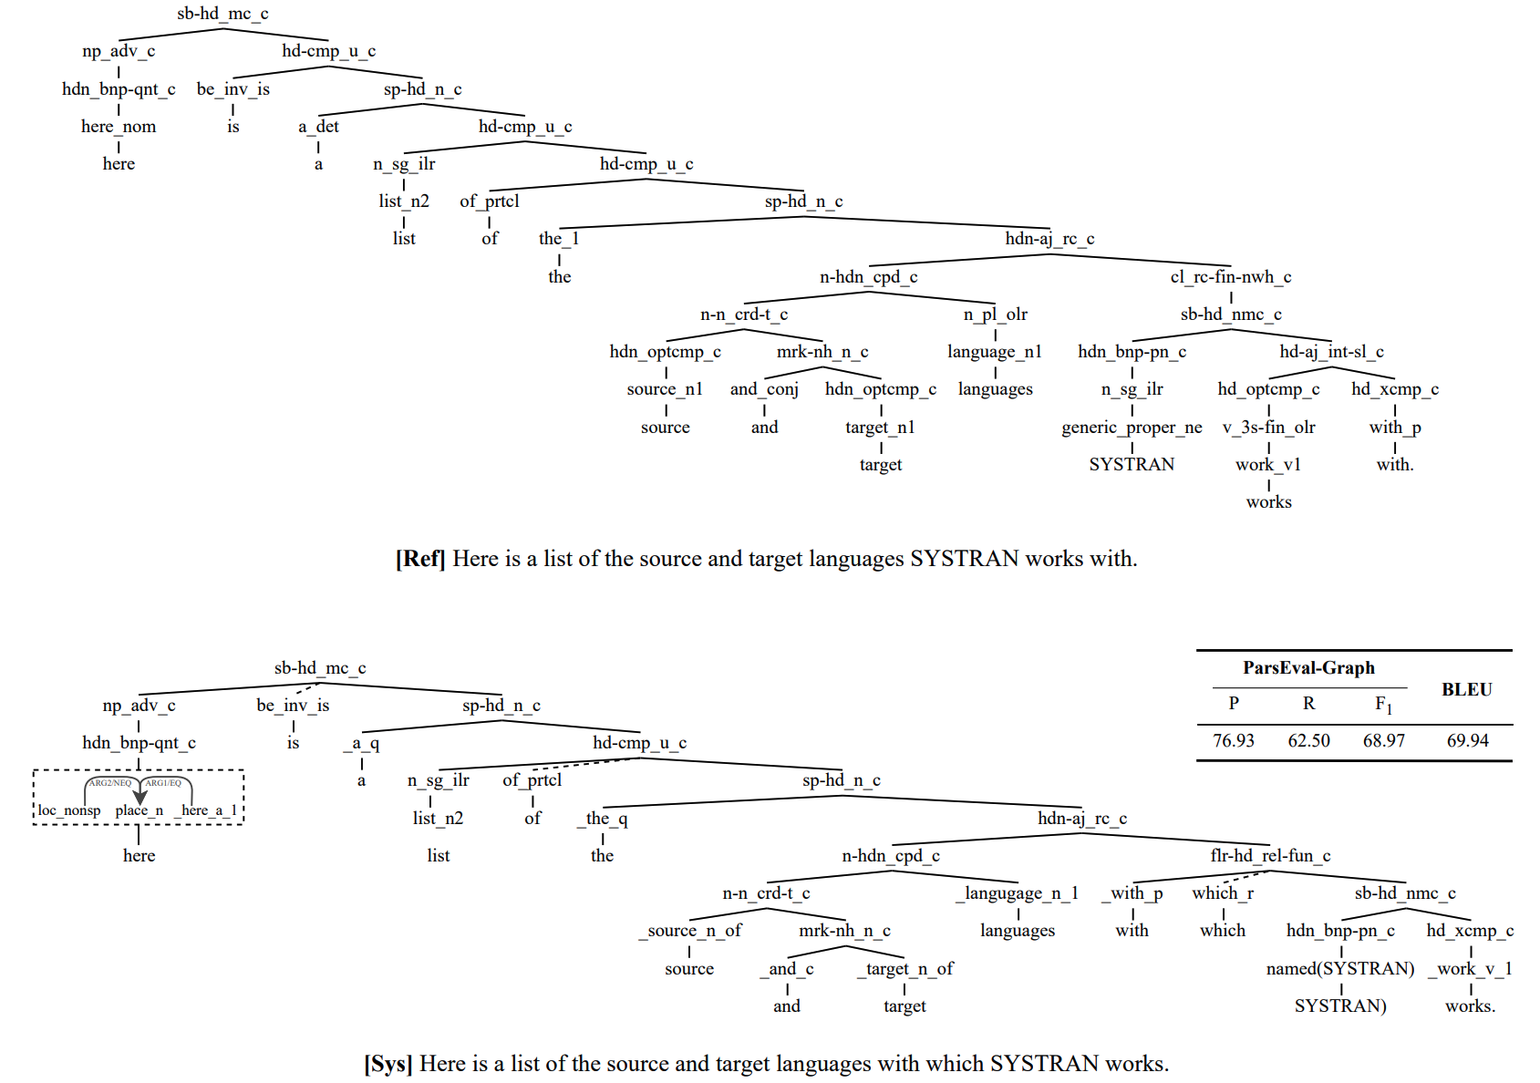
Notes:
We evaluate our models on two tasks.
[Click]
The main experiment is on derivation tree reconstruction
[Click]
And the secondary experiment is on surface realization, which can be obtained by realizing the terminals of the derivation tree.

Slide 49
Experiments Data
Main data set: The Ninth Growth of the Redwoods Treebank
#Training: 70,774
#Test: 10,042
Secondary data set: Gigaword v.5 corpus (parsed with the Answer Constraint Engine (ACE))
#Training: 70,774
Notes:
We experiment on two data sets, the Ninth Growth of the Redwoods Treebank
and the gigaword corpus.
The Redwoods Treebank contains English sentences from a range of domains
including Wall Street Journal (WSJ) and the Brown corpus, each paired with the analyses of the ERG.
To assess the scalability of our models, we further sampled
seventy thousand sentences from the Gigaword corpus for model training.
Extra training instances are obtained by parsing sentences with the ACE,
an ERG parser, and choosing the best ERG analysis for each sentence.

Slide 50
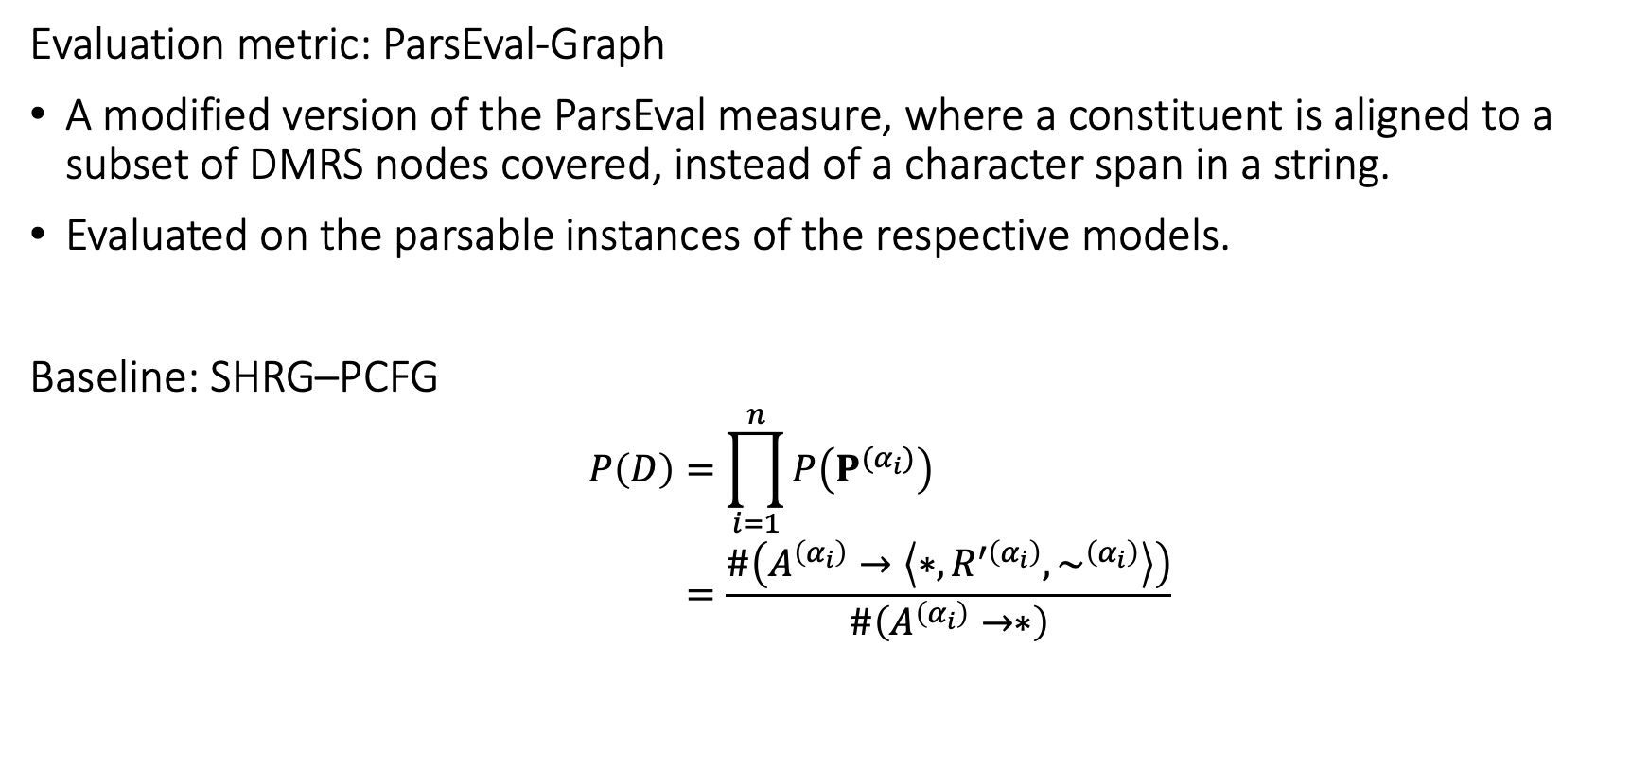
Experiments On Derivation Tree Reconstruction
Evaluation metric: ParsEval-Graph
A modified version of the ParsEval measure, where a constituent is aligned to a subset of DMRS nodes covered, instead of a character span in a string.
Evaluated on the parsable instances of the respective models.
Baseline: SHRG–PCFG
$$P\left(D\right)=\prod_{i=1}^{n}{P\left(P^{{(α}_{i})}\right)} \\ =\frac{\#\left(A^{\left(α_{i}\right)}→\left\langle ∗, R^{′\left(α_{i}\right)}, \sim ^{\left(α_{i}\right)}\right\rangle \right)}{\#\left(A^{\left(α_{i}\right)}→∗\right)}$$
Notes:
We devise a modified version of the ParsEval measure, ParsEval-Graph,
to assess the quality of the generated trees
because the constituents of the trees are not aligned to a surface string but to the input semantics.
All ParsEval-Graph scores are evaluated on the parsable instances of the respective models.
We develop a baseline model SHRG–PCFG for benchmarking,
which parses a DMRS with the SHRG induced.
The probability of each parse is given by a PCFG model..

Slide 51
Experiments On Derivation Tree Reconstruction
Notes:
From the left table, we see that all PSHRG models attain F1 scores of over 80
consistently across settings
and outperform the baseline under the same annotation configurations.
More extensive annotation and typing the grammar respectively improve the F1 score by about 2,
at the expense of coverage reduction caused by rule sparsity
From the right table, we see the coverages of the two models increase by about 5% with more data.
//but, the accuracy of derivations does not improve further, as frequency-based context-free probability models have low model capacities.

Slide 52
Experiments On Surface Realization
Evaluation metric: BLEU
Evaluated on the parsable instances of the respective models.
Baseline #1: Neural MRS
A neural seq-to-seq model
Baseline #2: The Answer Constraint Engine (ACE)
An HPSG-grammar-based generator
Notes:
For our second experiment on surface realization,
we evaluate the generation quality with BLEU.
All BLEU scores are evaluated on the parsable instances of the respective models.
We compare our work with the Neural MRS and the ACE,
which are a sequence-to-sequence model and a HPSG-based generator respectively

Slide 53
Experiments On Surface Realization
WSJ–WSJ:
#Training: 34,751
#Test: 1442
WSJ–Brown:
#Training: 34,751
#Test: 2181
Notes:
Table 3 shows that our models are not as good in some settings,
but outperform the Neural MRS under the out-of-domain settings
when the model is trained on Wall Street Journal data and tested on the Brown data.
Apart from the quantitative evaluation, we also report some syntactic variations observed in our models’ output.
For more in-depth discussion and results of ablation studies, please check out our paper.

Slide 54
Experiments Ablation Studies

Slide 55
Discussion
PSHRG
It is a shallow frequency-based parse ranking model
Surface realization model
We realized the most frequent surface forms for each terminal
We did not incorporate much linguistic knowledge
(S)HRG parser
This work focuses on correctness rather than efficiency.
Ye and Sun (2020) developed an efficient HRG parser on EDS (a close equivalent to DMRS, without scope information)
Different from their implementation, we:
retained more than 210 ERG syntactic constructions for precision
adopted delexicalization for generalization
both of which increase the search space of parsing and trade efficiency.
We added only part of MRS framework-specific constraints for composition
More constraints should further constrain the search space
There are more relevant optimization technique for efficiency we did not experiment with, e.g., delayed modifier insertion
Notes:
To summarize, we propose PSHRG-based models as
simple yet competitive data-driven baselines with framework-specific adaptations for recovering derivations of DMRS,
as a general approach to compositional graph-to-tree translation, and
as a solution to surface realization that provides explainability, syntactic disambiguation, and syntactic variations.
Thank you for listening

Slide 56
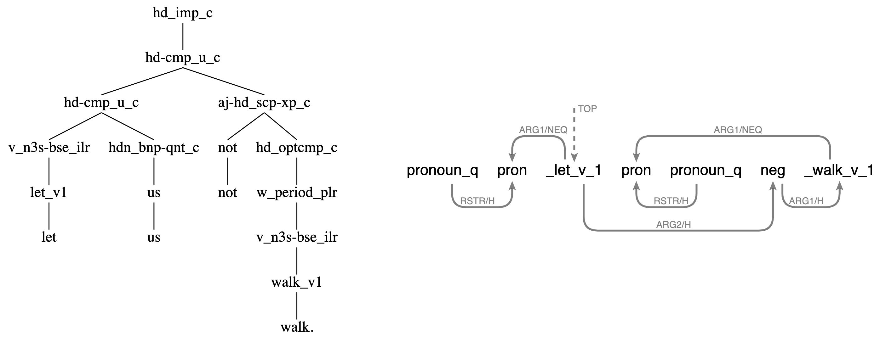
Discussion
Data-driven approximation vs. expressing a foreign grammar
Former: Approaching an SHRG from the data
Some semantic compositions of ERG cannot be captured by our SHRG, e.g., disconnected subgraphs:
Learning language-specific signals not totally available from the data
(D)MRS is a semantic representation that abstracts syntax away, e.g., semantically empty lexical items
We have to balance between rule sparseness, coverage and correctness
Notes:
To summarize, we propose PSHRG-based models as
simple yet competitive data-driven baselines with framework-specific adaptations for recovering derivations of DMRS,
as a general approach to compositional graph-to-tree translation, and
as a solution to surface realization that provides explainability, syntactic disambiguation, and syntactic variations.
Thank you for listening

Slide 57
Discussion
Data-driven approximation vs. expressing a foreign grammar
Latter: Approaching an SHRG from the ERG
The problem then turns to: Could we ‘map’ ERG to an ‘appropriate’ SHRG
The edges in an SHRG rule are predicate-agnostic
Semantic compositions of ERG not captured by SHRG
Composition constraints—We added only part of MRS framework-specific constraints for composition, namely the availability of LTOP and INDEX during compositions; incorporating the rest is still an open question.
If yes, what are the benefits of such a map?
Notes:
To summarize, we propose PSHRG-based models as
simple yet competitive data-driven baselines with framework-specific adaptations for recovering derivations of DMRS,
as a general approach to compositional graph-to-tree translation, and
as a solution to surface realization that provides explainability, syntactic disambiguation, and syntactic variations.
Thank you for listening

Slide 58
Summary
Derivation reconstruction from DMRS
MRS-specific adaptations in HRG
General compositional graph-to-tree translation
Surface realization with explainability, syntactic disambiguation, and syntactic variations
Notes:
To summarize, we propose PSHRG-based models as
simple yet competitive data-driven baselines with framework-specific adaptations for recovering derivations of DMRS,
as a general approach to compositional graph-to-tree translation, and
as a solution to surface realization that provides explainability, syntactic disambiguation, and syntactic variations.
Thank you for listening

Slide 59
Thank you!
Q&A
Notes:
To summarize, we propose PSHRG-based models as
simple yet competitive data-driven baselines with framework-specific adaptations for recovering derivations of DMRS,
as a general approach to compositional graph-to-tree translation, and
as a solution to surface realization that provides explainability, syntactic disambiguation, and syntactic variations.
Thank you for listening

Slide 60
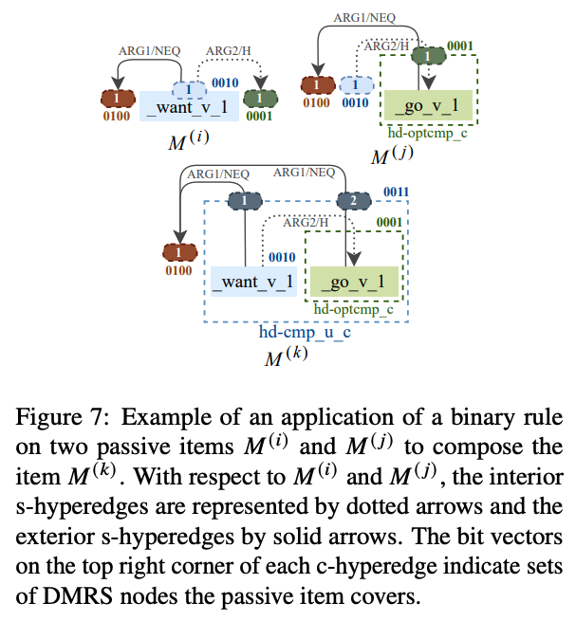
Appendix
Notes:
To summarize, we propose PSHRG-based models as
simple yet competitive data-driven baselines with framework-specific adaptations for recovering derivations of DMRS,
as a general approach to compositional graph-to-tree translation, and
as a solution to surface realization that provides explainability, syntactic disambiguation, and syntactic variations.
Thank you for listening

Slide 61
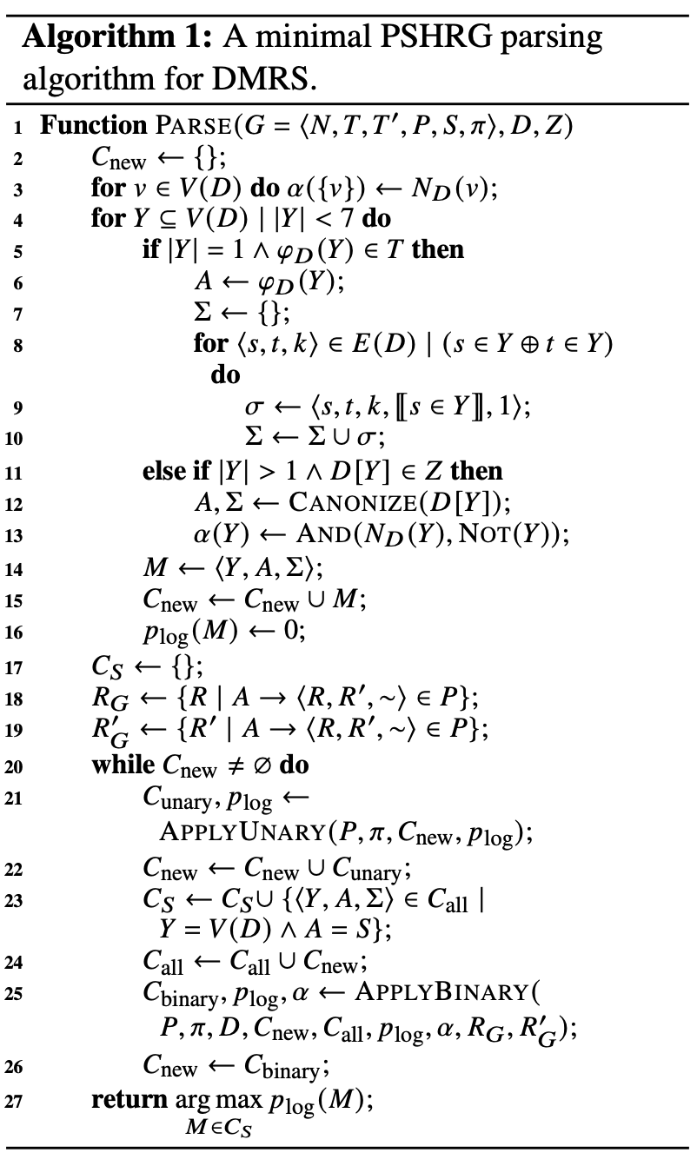
Appendix
Notes:
To summarize, we propose PSHRG-based models as
simple yet competitive data-driven baselines with framework-specific adaptations for recovering derivations of DMRS,
as a general approach to compositional graph-to-tree translation, and
as a solution to surface realization that provides explainability, syntactic disambiguation, and syntactic variations.
Thank you for listening

Slide 62
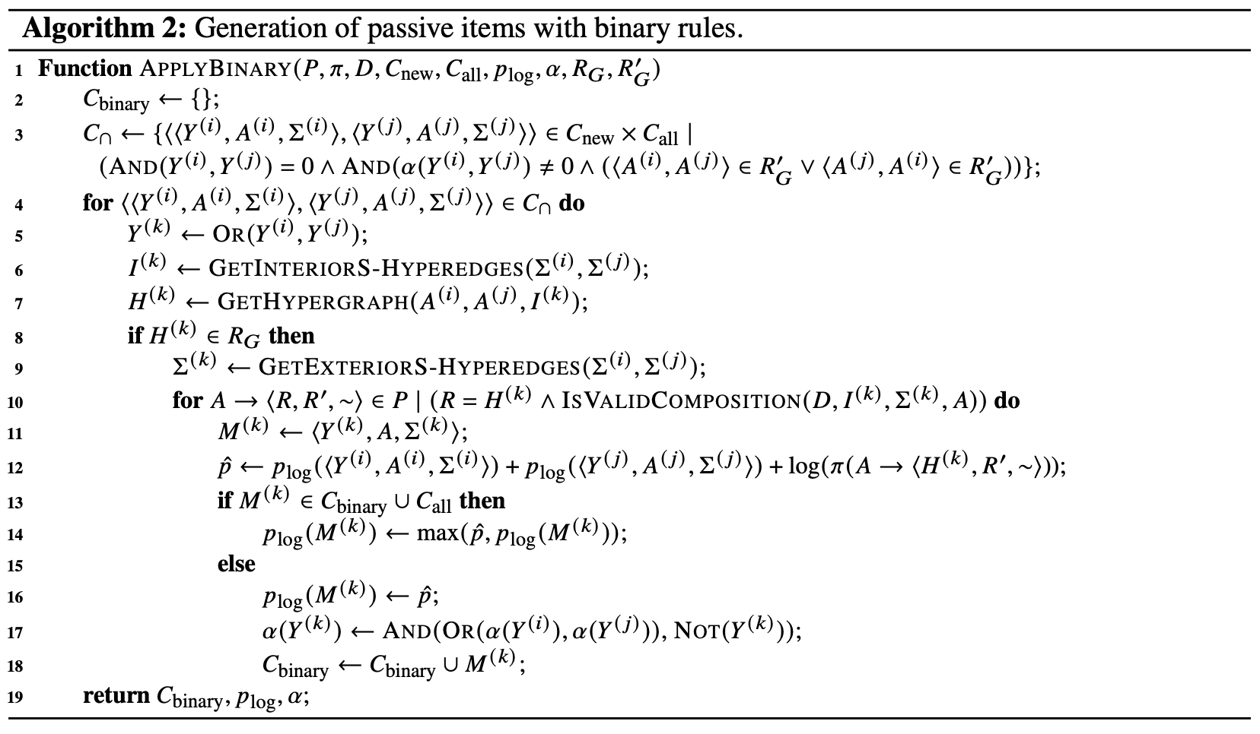
Appendix
Notes:
To summarize, we propose PSHRG-based models as
simple yet competitive data-driven baselines with framework-specific adaptations for recovering derivations of DMRS,
as a general approach to compositional graph-to-tree translation, and
as a solution to surface realization that provides explainability, syntactic disambiguation, and syntactic variations.
Thank you for listening

